Slide 1
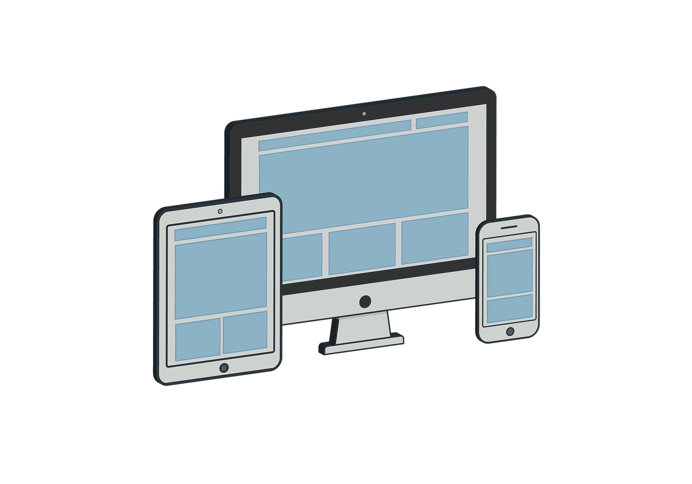
E-Commerce website designing & development
Redial India Solutions

Slide 2
What is E-Commerce?
E-Commerce commonly known as Electronic commerce. It consist of buying and selling product and services over an electronic systems Such as the internet and other computer networks.
It is the process of making money transfers, and transferring data over an electronic medium (Internet).
E-Commerce allows people to do business without the constraint of distance and time

Slide 3
Types of Ecommerce Models
Business to Consumer (B2C)
Business to Business (B2B)
Consumer to Consumer (C2C)
Consumer to Business (C2B)

Slide 4
Interesting, right?
This is just a sneak preview of the full presentation. We hope you like it! To see the rest of it, just click here to view it in full on PowerShow.com. Then, if you’d like, you can also log in to PowerShow.com to download the entire presentation for free.

